Slide 1
Quality Control part 2

Slide 2
Different Mechanisms for Quality Control
Aggregation and redundancy
Embedded gold standard data
Economic incentives
Reputation systems
Statistical models

Slide 3
Reputation systems
Mechanical Turk uses a reputation system
Each Turker has a small number of variables associated with them, that are exposed to Requesters
Past approval rate
Number of HITs approved
Has masters qualification (photo moderation/ categorization master)

Slide 4
Pros and Cons of MTurk’s reputation system
Pros | Cons
Gives a bit information about what other Requesters thought of a Worker | Reasons for rejections not shared; Weights all Requesters equally
Allows you to select Amazon’s master’s qualification, which is given to experienced Workers | It is not clear who gets the master’s qual. No way to share other qualifications.
 | Asymmetric: applies only to Workers, with no way to rate Requesters
Notes:
Others?

Slide 5
Confederated Trust
Acceptance rate doesn’t show how good a worker is at a particular task
Qualifications like the “photo moderation master’s” may show this
However, there is no way to share this information with other requesters
Lots of reinventing the wheel

Slide 6
Confederated Trust
Do you think it would be useful to share qualifications among requesters?
How would you do it?

Slide 7
Asymmetric reputation systems
No way for Turkers to rate requesters, and see beforehand who is scrupulous
Turkers have built their own external tools for this like TurkOpticon
No way to see whether a Turkers high rating comes from good Requesters

Slide 8
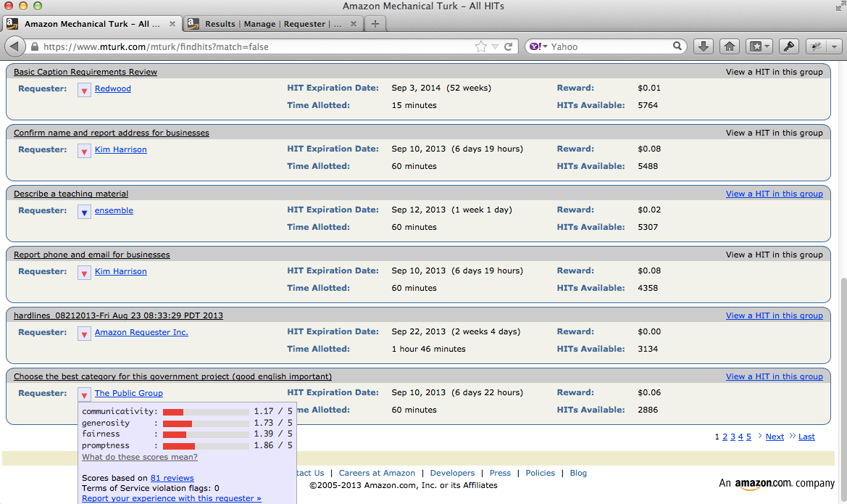
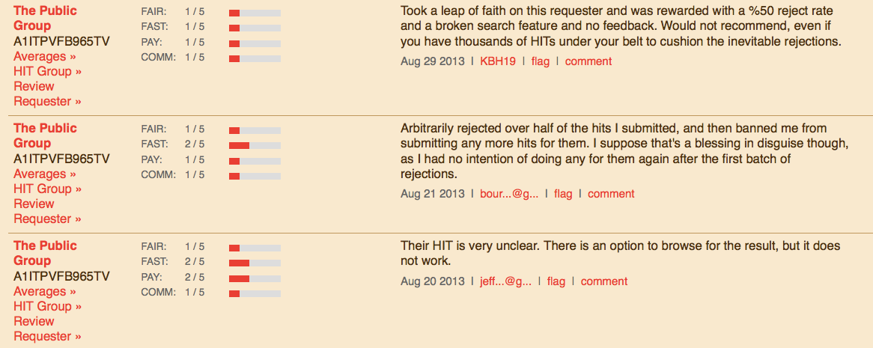

Slide 9
Qualitative v Quantitative
TurkOpticon's qualitative attributes | CrowdWorker's quantitative equivalents
promptness: How promptly has this requester approved your work and paid? | Expected time to payment: On average, how much time elapses between submitting work to this Requester and receiving payment?
generosity: How well has this requester paid for the amount of time their HITs take? | Average hourly rate: What is the average hourly rate that other Turker make when they do this requester's HITs?
fairness: How fair has this requester been in approving or rejecting your work? | Approval/rejection rates: What percent of assignments does this Requester approve? What percent of first-time Workers get any work rejected?
communicativity: How responsive has this requester been to communications or concerns you have raised? | Reasons for rejection: Archive of all of the reasons for Workers being rejected or blocked by this Requester.

Slide 10
Amazon’s other reputation system
Amazon has another reputation system in place for its online stores
Amazon allows anyone to list and sell items through its site, and to set their own prices
These can be individuals selling used goods, or independent 3rd party sellers who use Amazon to reach a larger customer base
How does Amazon ensure good customer experience?

Slide 11
Feedback from buyers
How satisfied were you with how your order was packaged and shipped?
If you contacted the third-party seller, did you get good customer service and prompt resolution?
Would you buy from this third-party seller again?

Slide 12
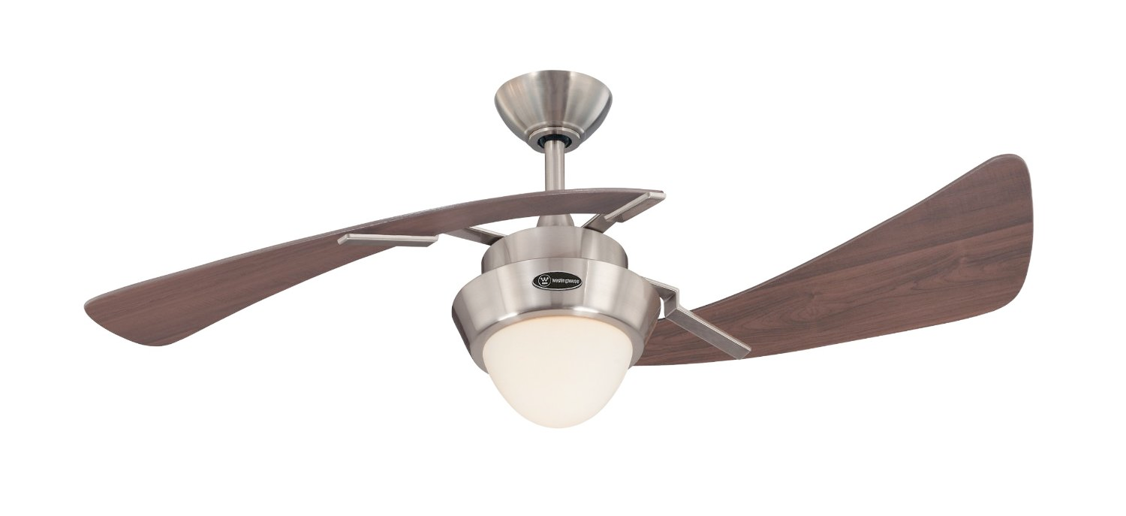
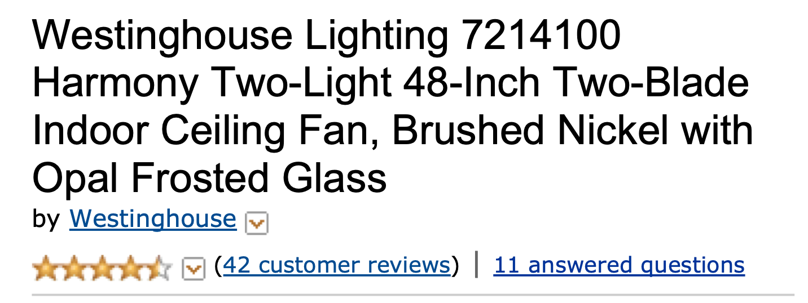

Slide 13
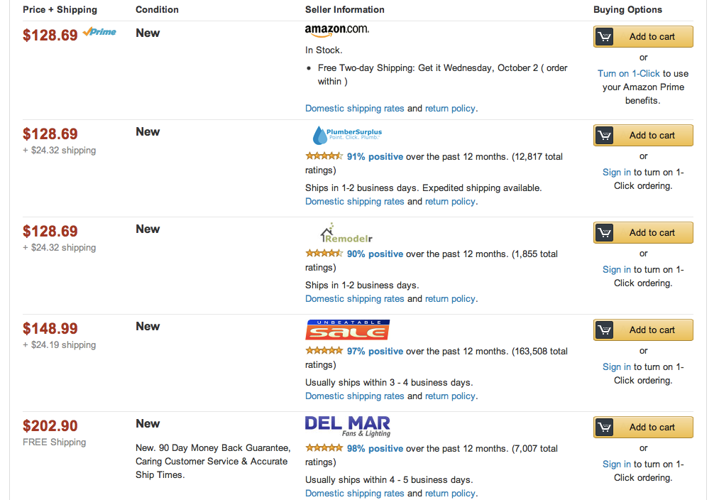
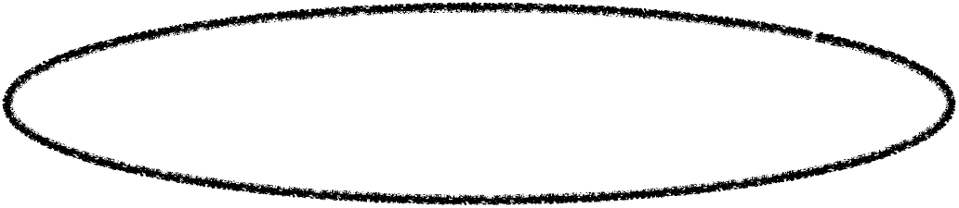

Slide 14
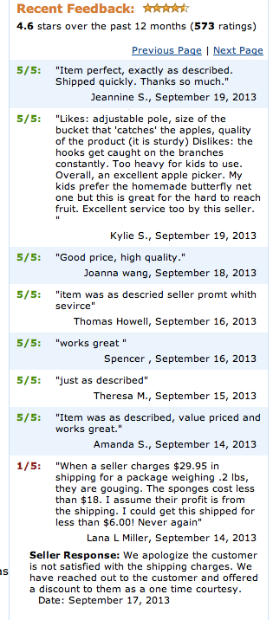
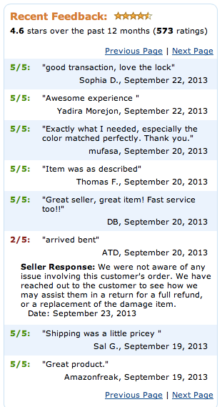

Slide 15
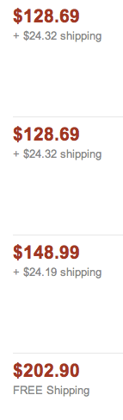
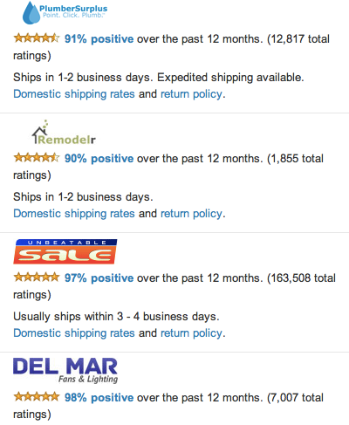
What are the economic implications of poor feedback?

Slide 16
Price premium
Multiple sellers all selling the same item, but at different prices
Price premium is the difference between a cheaper listing and a more expensive listing
When someone opts for the more expensive item, even though it is identical, what is the reason for paying the premium?

Slide 17
Data-driven analysis
Panos Ipeirotis harvested data from Amazon’s website
Gathered transaction data by repeatedly visiting listings (every 8 hours) and tracking when one item sold
Gathered reputation data for each merchant. Complete history of numerical scores and text-based feedback
Notes:
Amazon Web Services associates a unique transaction ID for each unique product listed by a seller. This transaction ID enables us to distinguish between multiple or successive listings of identical products sold by the same merchant.

Slide 18
Data-driven analysis
Data set gathered over half a year period
Transaction data contains 1,078 merchants, 9,484 unique transactions and 107,922 price premiums
Reputation data contains an average of 4,932 postings for each merchant

Slide 19
NLP + Economics
Quantify the economics impact of sentiment of the feedback evaluations
Using natural language processing techniques to derive semantic orientation and strength of comments

Slide 20
Method
Each merchant’s reputation is represented using a vector of n-dimensions X = (X1, X2, ... XN)
Dimensions were 150 nouns and verbs, values of dimensions could be one of 140 modifiers
X1 is “delivery,” X2 is “packaging,” X3 is “service.”
Feedback 1 “I was impressed by the speedy delivery! Great service!”: (speedy ; NULL; great)
Feedback 2 “The item arrived in awful packaging, and the delivery was slow”: (slow ; awful ; NULL)

Slide 21
Method
Construct a matrix out of all of the feedback for a seller
Weight the more recent feedback more heavily
Calculate how the values of each dimension effect the price premium
Use least-squares regression with fixed effects to predict the price premium

Slide 22
Highest scoring phrases
wonderful experience | $5.86
outstanding seller | $5.76
excellant service | $5.27
lightning delivery | $4.84
highly recommended | $4.15
best seller | $3.80
perfectly packaged | $3.74
excellent condition | $3.53
excellent purchase | $3.22
excellent seller | $2.70
excellent communication | $2.38
perfect item | $1.92
terrific condition | $1.87
top quality | $1.67
awesome service | $1.05
A+++ seller | $1.03
great merchant | $0.93
friendly service | $0.81
easy service | $0.78
never received | -$7.56
defective product | -$6.82
horrible experience | -$6.79
never sent | -$6.69
never recieved | -$5.29
bad experience | -$5.26
cancelled order | -$5.01
never responded | -$4.87
wrong product | -$4.39
not as advertised | -$3.93
poor packaging | -$2.92
late shipping | -$2.89
wrong item | -$2.50
not yet received | -$2.35
still waiting | -$2.25
wrong address | -$1.54
never buy | -$1.48

Slide 23
Predicting the merchant who makes the sale

Slide 24
Challenges for Reputation Systems
Not enough people participate
Feedback tends to be overwhelmingly positive
Reports can be dishonest
Reputation systems are undermined if people can change identities easily
People can milk a good reputation

Slide 25
Insufficient participation
Giving feedback for a reputation system contributes to the public good
However, after some information is available it is easy for people to be "free riders" without contributing anything
Early raters take on a transaction cost (Yelpers risk going to bad restaurants with no reviews)
Solutions?
Notes:
Make every participant submit a rating
Avery􏰀et􏰀al.􏰀1999]􏰀propose 􏰀 a􏰀mechanism􏰀 whereby􏰀 early􏰀 evaluators 􏰀are 􏰀paid 􏰀to 􏰀provide 􏰀information􏰀 and 􏰀later 􏰀evaluators􏰀 pay 􏰀to 􏰀balance 􏰀the 􏰀budget.

Slide 26
Overwhelmingly positive feedback
99% of all feedback on eBay is positive
Part of the problem is reciprocity
Sellers and buyers evaluate each other
Positive ratings are given in the hopes of getting positive ratings in return
Negative ratings are avoided for fear of getting negative feedback as retaliation
Notes:
Solutions to overwhelmingly positive feedback?
1. Anonymous feedback
2. Take non-feedback into account

Slide 27
Dishonest reports
Ballot stuffing - a seller colludes with buyers to give unfairly high ratings
Bad mouthing - collusion to give negative feedback about competitors that they want to drive out of the market

Slide 28
Identity changes
Cheap pseudonyms - easy to disappear and re-register under a new identity with almost zero cost
Can misbehave without paying consequences toward reputation
Notes:
1. Increase the difficulty of changing identities
2. Impose upfront costs to new entrants - ok to discard a past identity but it costs something to start a new one.

Slide 29
Value imbalance exploitations
People who want to commit fraud could first invest in building a good reputation
Ebay exploit: "Riddle for 1¢. No shipping. Positive feedback"
Sellers would take a 29¢ loss to build up positive reputation quickly
Notes:
1. Make details of transactions visible to other users
2. Transaction-weighted reputation systems

Slide 30
Challenges for Crowdsourcing Markets
Reciprocal systems are worse than 1-sided systems in e-commerce.
In e-commerce, only the sellers are likely to behave opportunistically. No need for reciprocal evaluation.
In crowdsourcing, both sides can be fraudulent. So reciprocal markets are important, but they are hard to get right!

Slide 31
Challenges for Crowdsourcing Markets
In e-commerce markets, it is straightforward for buyers to evaluate the quality of the product when they receive it.
In crowdsourcing markets, verifying the correct answer is sometimes as costly as producing it.
This has the potential to significantly reduce participation and/or accuracy of reviews

Slide 32
Challenges for Crowdsourcing Markets
No "price premium" for high quality workers
In e-commerce markets, sellers with a good reputation can sell their goods at a relatively high price (premium)
In crowdsourcing, the requester sets the price, and this is typically the same for all workers

Slide 33
Quality Control part 3

Slide 34
Different Mechanisms for Quality Control
Aggregation and redundancy
Embedded gold standard data
Economic incentives
Reputation systems
Statistical models

Slide 35
Expectation Maximization algorithm
EM is an algorithm for finding the probabilities of unobserved variables
We will use it to estimate how accurate workers’ labels are, and infer how good each worker is
This is more sophisticated than voting

Slide 36
Dawid and Skene (1977)
Maximum Likelihood Estimation of Observer Error-rates using the EM Algorithm
Examined application to medical diagnosis
Patients are sometimes treated by multiple physicians, who can give different diagnoses
Why? Doctors may has different questions. Patient may describe history differently. Doctors may classify symptoms differently

Slide 37
Observer Error
Given that different doctors have different opinions, they can’t all be right.
How often do individual physicians suffer from “observer error”? Are their errors systematic?
Answers depend on the “true” diagnosis.

Slide 38
Observer Error
Observer error would be easy to calculate if we had ground truth
Simply count the misdiagnoses and divide by the total number of diagnoses
However, sometimes it is impossible to know what diagnosis is correct. Same set of symptoms can arise from multiple root causes.

Slide 39

“I know it when I see it”
I shall not today attempt further to define "hard-core pornography"; and perhaps I could never succeed in intelligibly doing so. But I know it when I see it.
—Justice Potter Stewart
Notes:
Jacobellis v. Ohio[5] (1964) created the standard whereby all speech is protected except for "hard-core pornography". As for what, exactly, constitutes hard-core pornography, Stewart said "I shall not today attempt further to define the kinds of material I understand to be embraced within that shorthand description, and perhaps I could never succeed in intelligibly doing so. But I know it when I see it, and the motion picture involved in this case is not that."

Slide 40
url | worker1 | worker2 | worker3 | worker4 | worker5
sunnyfun.com | porn | not | not | not | porn
sex-mission.com | porn | porn | porn | porn | porn
google.com | not | porn | not | not | porn
youporn.com | porn | porn | porn | porn | not
yahoo.com | porn | not | not | not | porn
Notes:
* worker1 is lazy, and gives the answer porn all the time
* worker2 is ok but not great. For example, labeled object3 as porn even though it is notporn
* worker3 and worker4 are high-quality workers
* worker5 is malicious, giving always the incorrect answer, trying to fool the system
https://github.com/ipeirotis/Get-Another-Label/tree/master/data/AdultContent

Slide 41
Solution?
Can’t have Justice Stewart rule on everything
Instead, we will apply Dawid and Skene’s EM algorithm, which iteratively
Estimates the correct answers, using labels from multiple workers, and accounts for the quality of each worker
Estimates the quality of the workers by comparing the submitted answers to the inferred correct answers

Slide 42
Inputs
a set of N objects o1 ... oN sunnyfun.com, sex-mission.com, google.com, youporn.com, yahoo.com
a set of L possible labels: {porn, not porn}
Labels for each object by K workers worker1, worker2, worker3, worker4, worker5

Slide 43
Goal 1
Recover the true class label T(on) for each object on when “gold” truth is unknown
Since the true labels are not known / never directly observed, they are called latent variables

Slide 44
Goal 2
For each worker who contributed labels, calculate their accuracy or reliability
To calculate accuracy show how often they mistakenly choose one label when a different one is the actual truth
Notes:
In the binary case, this is simple. In the multi-label case, as we will see later, knowing what classes they confuse gets pretty interesting.

Slide 45
Chicken and egg problem
If we knew what the true class labels were for each object for each object, then we could compute each Turker’s accuracy
If we had accuracies for every Turker, then we could infer what the true label for each object should be

Slide 46
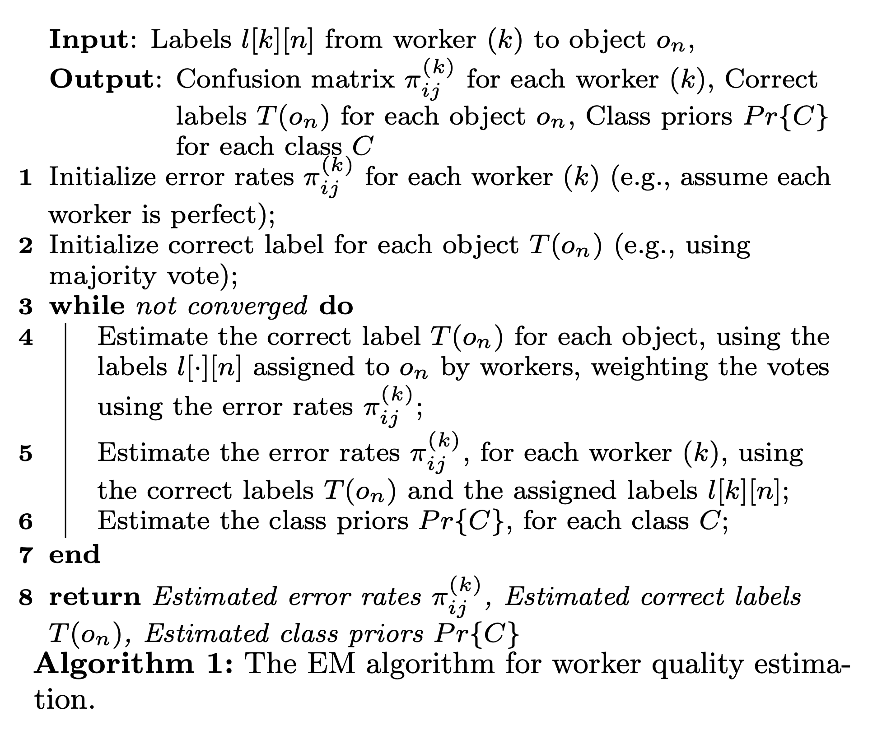
Notes:
Input: Labels l[k][n] from worker (k) to object on,
Output: Confusion matrix π^{(k)} for each worker (k), Correct
ij
ij
labels T(on) for each object on, Class priors Pr{C}
for each class C
1 Initialize error rates π^{(k)} for each worker (k) (e.g., assume each
ij
worker is perfect);
2 Initialize correct label for each object T(on) (e.g., using
majority vote);
3 while not converged do
4 Estimate the correct label T(on) for each object, using the
labels l[·][n] assigned to on by workers, weighting the votes using the error rates π^{(k)};
ij
5 Estimate the error rates π^{(k)}, for each worker (k), using ij
the correct labels T(on) and the assigned labels l[k][n];
6 Estimate the class priors Pr{C}, for each class C;
7 end
8 return Estimated error rates π^{(k)}, Estimated correct labels ij
T(on), Estimated class priors Pr{C}
Algorithm 1: The EM algorithm for worker quality estima- tion.

Slide 47
 | worker1 | worker2 | worker3 | worker4 | worker5
sunnyfun.com | porn | not | not | not | porn
sex-mission.com | porn | porn | porn | porn | porn
google.com | not | porn | not | not | porn
youporn.com | porn | porn | porn | porn | not
yahoo.com | porn | not | not | not | porn

Slide 48
Output: “True” Labels
url | True Labels
sunnyfun.com | not
sex-mission.com | porn
google.com | not
youporn.com | porn
yahoo.com | not

Slide 49
Repeat until convergence
You can continue to iterate until your values converge
For this example, we converge after the first iteration

Slide 50
 | worker1 | worker2 | worker3 | worker4 | worker5
sunnyfun.com | porn | not | not | not | porn
sex-mission.com | porn | porn | porn | porn | porn
google.com | not | porn | not | not | porn
youporn.com | porn | porn | porn | porn | not
yahoo.com | porn | not | not | not | porn

Slide 51
 | worker1 | worker2 | worker3 | worker4 | worker5
sunnyfun | porn | not | not | not | porn
sex-mission | porn | porn | porn | porn | porn
google | not | porn | not | not | porn
youporn | porn | porn | porn | porn | not
yahoo | porn | not | not | not | porn
worker1 | porn | not
porn | ? | ?
not | ? | ?
worker2 | porn | not
porn | ? | ?
not | ? | ?
 | porn | not
sunnyfun | ? | ?
sex-mission | ? | ?
google | ? | ?
youporn | ? | ?
yahoo | ? | ?
worker3 | porn | not
porn | ? | ?
not | ? | ?
worker4 | porn | not
porn | ? | ?
not | ? | ?
worker5 | porn | not
porn | ? | ?
not | ? | ?
Notes:
Columns show worker’s guess
Rows show “truth”

Slide 52

 | worker1 | worker2 | worker3 | worker4 | worker5
sunnyfun | porn | not | not | not | porn
sex-mission | porn | porn | porn | porn | porn
google | not | porn | not | not | porn
youporn | porn | porn | porn | porn | not
yahoo | porn | not | not | not | porn
worker1 | porn | not
porn | 1 | 0
not | 0 | 1
Initialize confusion matrices to uniform
worker2 | porn | not
porn | 1 | 0
not | 0 | 1
 | porn | not
sunnyfun | ? | ?
sex-mission | ? | ?
google | ? | ?
youporn | ? | ?
yahoo | ? | ?
worker3 | porn | not
porn | 1 | 0
not | 0 | 1
worker4 | porn | not
porn | 1 | 0
not | 0 | 1
worker5 | porn | not
porn | 1 | 0
not | 0 | 1

Slide 53
 | worker1 | worker2 | worker3 | worker4 | worker5
sunnyfun | porn | not | not | not | porn
sex-mission | porn | porn | porn | porn | porn
google | not | porn | not | not | porn
youporn | porn | porn | porn | porn | not
yahoo | porn | not | not | not | porn
worker1 | porn | not
porn | 1 | 0
not | 0 | 1
worker2 | porn | not
porn | 1 | 0
not | 0 | 1
 | porn | not
sunnyfun | 2 | ?
sex-mission | ? | ?
google | ? | ?
youporn | ? | ?
yahoo | ? | ?
worker3 | porn | not
porn | 1 | 0
not | 0 | 1
worker4 | porn | not
porn | 1 | 0
not | 0 | 1
Compute labels using majority vote
worker5 | porn | not
porn | 1 | 0
not | 0 | 1

Slide 54
 | worker1 | worker2 | worker3 | worker4 | worker5
sunnyfun | porn | not | not | not | porn
sex-mission | porn | porn | porn | porn | porn
google | not | porn | not | not | porn
youporn | porn | porn | porn | porn | not
yahoo | porn | not | not | not | porn
worker1 | porn | not
porn | 1 | 0
not | 0 | 1
worker2 | porn | not
porn | 1 | 0
not | 0 | 1
 | porn | not
sunnyfun | 2 | 3
sex-mission | ? | ?
google | ? | ?
youporn | ? | ?
yahoo | ? | ?
worker3 | porn | not
porn | 1 | 0
not | 0 | 1
worker4 | porn | not
porn | 1 | 0
not | 0 | 1
Compute labels using majority vote
worker5 | porn | not
porn | 1 | 0
not | 0 | 1

Slide 55
 | worker1 | worker2 | worker3 | worker4 | worker5
sunnyfun | porn | not | not | not | porn
sex-mission | porn | porn | porn | porn | porn
google | not | porn | not | not | porn
youporn | porn | porn | porn | porn | not
yahoo | porn | not | not | not | porn
worker1 | porn | not
porn | 0 | 0
not | 0 | 0
worker2 | porn | not
porn | 0 | 0
not | 0 | 0
 | porn | not
sunnyfun | 0 | 1
sex-mission | 1 | 0
google | 0 | 1
youporn | 1 | 0
yahoo | 0 | 1
worker3 | porn | not
porn | 0 | 0
not | 0 | 0
worker4 | porn | not
porn | 0 | 0
not | 0 | 0
Treat the correct label as the one with the most votes
worker5 | porn | not
porn | 0 | 0
not | 0 | 0

Slide 56

 | worker1 | worker2 | worker3 | worker4 | worker5
sunnyfun | porn | not | not | not | porn
sex-mission | porn | porn | porn | porn | porn
google | not | porn | not | not | porn
youporn | porn | porn | porn | porn | not
yahoo | porn | not | not | not | porn
worker1 | porn | not
porn | 2 | 0
not | 0 | 0
worker2 | porn | not
porn | 0 | 0
not | 0 | 0
Recompute worker confusion matrices…as though your labels are 100% correct
 | porn | not
sunnyfun | 0 | 1
sex-mission | 1 | 0
google | 0 | 1
youporn | 1 | 0
yahoo | 0 | 1
worker3 | porn | not
porn | 0 | 0
not | 0 | 0
worker4 | porn | not
porn | 0 | 0
not | 0 | 0
worker5 | porn | not
porn | 0 | 0
not | 0 | 0

Slide 57
 | worker1 | worker2 | worker3 | worker4 | worker5
sunnyfun | porn | not | not | not | porn
sex-mission | porn | porn | porn | porn | porn
google | not | porn | not | not | porn
youporn | porn | porn | porn | porn | not
yahoo | porn | not | not | not | porn
worker1 | porn | not
porn | 2 | 0
not | 2 | 0
worker2 | porn | not
porn | 0 | 0
not | 0 | 0
Recompute worker confusion matrices…as though your labels are 100% correct
 | porn | not
sunnyfun | 0 | 1
sex-mission | 1 | 0
google | 0 | 1
youporn | 1 | 0
yahoo | 0 | 1
worker3 | porn | not
porn | 0 | 0
not | 0 | 0
worker4 | porn | not
porn | 0 | 0
not | 0 | 0
worker5 | porn | not
porn | 0 | 0
not | 0 | 0

Slide 58
 | worker1 | worker2 | worker3 | worker4 | worker5
sunnyfun | porn | not | not | not | porn
sex-mission | porn | porn | porn | porn | porn
google | not | porn | not | not | porn
youporn | porn | porn | porn | porn | not
yahoo | porn | not | not | not | porn
worker1 | porn | not
porn | 2 | 0
not | 2 | 0
worker2 | porn | not
porn | 0 | 0
not | 0 | 0
Recompute worker confusion matrices…as though your labels are 100% correct
 | porn | not
sunnyfun | 0 | 1
sex-mission | 1 | 0
google | 0 | 1
youporn | 1 | 0
yahoo | 0 | 1
worker3 | porn | not
porn | 0 | 0
not | 0 | 0
worker4 | porn | not
porn | 0 | 0
not | 0 | 0
worker5 | porn | not
porn | 0 | 0
not | 0 | 0

Slide 59
 | worker1 | worker2 | worker3 | worker4 | worker5
sunnyfun | porn | not | not | not | porn
sex-mission | porn | porn | porn | porn | porn
google | not | porn | not | not | porn
youporn | porn | porn | porn | porn | not
yahoo | porn | not | not | not | porn
worker1 | porn | not
porn | 2 | 0
not | 2 | 1
worker2 | porn | not
porn | 0 | 0
not | 0 | 0
Recompute worker confusion matrices…as though your labels are 100% correct
 | porn | not
sunnyfun | 0 | 1
sex-mission | 1 | 0
google | 0 | 1
youporn | 1 | 0
yahoo | 0 | 1
worker3 | porn | not
porn | 0 | 0
not | 0 | 0
worker4 | porn | not
porn | 0 | 0
not | 0 | 0
worker5 | porn | not
porn | 0 | 0
not | 0 | 0

Slide 60

 | worker1 | worker2 | worker3 | worker4 | worker5
sunnyfun | porn | not | not | not | porn
sex-mission | porn | porn | porn | porn | porn
google | not | porn | not | not | porn
youporn | porn | porn | porn | porn | not
yahoo | porn | not | not | not | porn
worker1 | porn | not
porn | 1 | 0
not | 0.67 | 0.33
worker2 | porn | not
porn | 0 | 0
not | 0 | 0
Renormalize confusion matrices (based on true labels)
 | porn | not
sunnyfun | 0 | 1
sex-mission | 1 | 0
google | 0 | 1
youporn | 1 | 0
yahoo | 0 | 1
worker3 | porn | not
porn | 0 | 0
not | 0 | 0
worker4 | porn | not
porn | 0 | 0
not | 0 | 0
worker5 | porn | not
porn | 0 | 0
not | 0 | 0

Slide 61
 | worker1 | worker2 | worker3 | worker4 | worker5
sunnyfun | porn | not | not | not | porn
sex-mission | porn | porn | porn | porn | porn
google | not | porn | not | not | porn
youporn | porn | porn | porn | porn | not
yahoo | porn | not | not | not | porn
worker1 | porn | not
porn | 1 | 0
not | 0.67 | 0.33
worker2 | porn | not
porn | 1 | 0
not | 0.33 | 0.67
Renormalize confusion matrices (based on true labels)
 | porn | not
sunnyfun | 0 | 1
sex-mission | 1 | 0
google | 0 | 1
youporn | 1 | 0
yahoo | 0 | 1
worker3 | porn | not
porn | 1 | 0
not | 0 | 1
worker4 | porn | not
porn | 1 | 0
not | 0 | 1
worker5 | porn | not
porn | 0.5 | 0.5
not | 1 | 0

Slide 62
 | worker1 | worker2 | worker3 | worker4 | worker5
sunnyfun | porn | not | not | not | porn
sex-mission | porn | porn | porn | porn | porn
google | not | porn | not | not | porn
youporn | porn | porn | porn | porn | not
yahoo | porn | not | not | not | porn
worker1 | porn | not
porn | 1 | 0
not | 0.67 | 0.33
worker2 | porn | not
porn | 1 | 0
not | 0.33 | 0.67
 | porn | not
sunnyfun | 1.5
sex-mission
google
youporn
yahoo
worker3 | porn | not
porn | 1 | 0
not | 0 | 1
Recompute labels using weighted majority vote
worker4 | porn | not
porn | 1 | 0
not | 0 | 1
worker5 | porn | not
porn | 0.5 | 0.5
not | 1 | 0

Slide 63
 | worker1 | worker2 | worker3 | worker4 | worker5
sunnyfun | porn | not | not | not | porn
sex-mission | porn | porn | porn | porn | porn
google | not | porn | not | not | porn
youporn | porn | porn | porn | porn | not
yahoo | porn | not | not | not | porn
worker1 | porn | not
porn | 1 | 0
not | 0.67 | 0.33
worker2 | porn | not
porn | 1 | 0
not | 0.33 | 0.67
 | porn | not
sunnyfun | 1.5 | 4.34
sex-mission
google
youporn
yahoo
worker3 | porn | not
porn | 1 | 0
not | 0 | 1
Recompute labels using weighted majority vote
worker4 | porn | not
porn | 1 | 0
not | 0 | 1
worker5 | porn | not
porn | 0.5 | 0.5
not | 1 | 0

Slide 64
 | worker1 | worker2 | worker3 | worker4 | worker5
sunnyfun | porn | not | not | not | porn
sex-mission | porn | porn | porn | porn | porn
google | not | porn | not | not | porn
youporn | porn | porn | porn | porn | not
yahoo | porn | not | not | not | porn
worker1 | porn | not
porn | 1 | 0
not | 0.67 | 0.33
worker2 | porn | not
porn | 1 | 0
not | 0.33 | 0.67
 | porn | not
sunnyfun | 0.26 | 0.74
sex-mission | 0.69 | 0.31
google | 0.29 | 0.71
youporn | 0.82 | 0.18
yahoo | 0.26 | 0.74
worker3 | porn | not
porn | 1 | 0
not | 0 | 1
Recompute labels using weighted majority vote
worker4 | porn | not
porn | 1 | 0
not | 0 | 1
worker5 | porn | not
porn | 0.5 | 0.5
not | 1 | 0

Slide 65
 | worker1 | worker2 | worker3 | worker4 | worker5
sunnyfun | porn | not | not | not | porn
sex-mission | porn | porn | porn | porn | porn
google | not | porn | not | not | porn
youporn | porn | porn | porn | porn | not
yahoo | porn | not | not | not | porn
worker1 | porn | not
porn | 1 | 0
not | 0.67 | 0.33
worker2 | porn | not
porn | 1 | 0
not | 0.33 | 0.67
 | porn | not
sunnyfun | 0 | 1
sex-mission | 1 | 0
google | 0 | 1
youporn | 1 | 0
yahoo | 0 | 1
worker3 | porn | not
porn | 1 | 0
not | 0 | 1
worker4 | porn | not
porn | 1 | 0
not | 0 | 1
Treat the correct label as the one with the most votes
worker5 | porn | not
porn | 0.5 | 0.5
not | 1 | 0

Slide 66
 | worker1 | worker2 | worker3 | worker4 | worker5
sunnyfun | porn | not | not | not | porn
sex-mission | porn | porn | porn | porn | porn
google | not | porn | not | not | porn
youporn | porn | porn | porn | porn | not
yahoo | porn | not | not | not | porn
worker1 | porn | not
porn | 1 | 0
not | 0.67 | 0.33
worker2 | porn | not
porn | 1 | 0
not | 0.33 | 0.67
Recompute worker confusion matrices…as though your labels are 100% correct
 | porn | not
sunnyfun | 0 | 1
sex-mission | 1 | 0
google | 0 | 1
youporn | 1 | 0
yahoo | 0 | 1
worker3 | porn | not
porn | 1 | 0
not | 0 | 1
worker4 | porn | not
porn | 1 | 0
not | 0 | 1
worker5 | porn | not
porn | 0.5 | 0.5
not | 1 | 0

Slide 67
 | worker1 | worker2 | worker3 | worker4 | worker5
sunnyfun | porn | not | not | not | porn
sex-mission | porn | porn | porn | porn | porn
google | not | porn | not | not | porn
youporn | porn | porn | porn | porn | not
yahoo | porn | not | not | not | porn
worker1 | porn | not
porn | 1 | 0
not | 0.67 | 0.33
worker2 | porn | not
porn | 1 | 0
not | 0.33 | 0.67
 | porn | not
sunnyfun | 0.26 | 0.74
sex-mission | 0.69 | 0.31
google | 0.29 | 0.71
youporn | 0.82 | 0.18
yahoo | 0.26 | 0.74
worker3 | porn | not
porn | 1 | 0
not | 0 | 1
Iterate until convergence.
worker4 | porn | not
porn | 1 | 0
not | 0 | 1
worker5 | porn | not
porn | 0.5 | 0.5
not | 1 | 0

Slide 68
Question
How would you use gold standard data in the EM process?

Slide 69
EM Algorithm
Re-Calculate Worker Scores over two steps:
Estimate the probability that each answer is correct, using labels from multiple workers weighted by the probability that they are correct
Estimate the quality of the workers by comparing their submitted answers to the inferred correct answers

Slide 70
Confusion Matrix Gives us Worker Error
From the confusion matrix we can measure the overall error rate for each worker
Sum of the non-diagonal elements of the confusion matrix (weighted by the priors)
This results in a single, scalar value as the quality score for each worker

Slide 71
Worker error
worker1 | porn | not
porn | 1 | 0
not | 0.67 | 0.33
worker3 | porn | not
porn | 1 | 0
not | 0 | 1
worker5 | porn | not
porn | 0.5 | 0.5
not | 1 | 0
.67
0
1.5
worker2 | porn | not
porn | 1 | 0
not | 0.33 | 0.67
worker4 | porn | not
porn | 1 | 0
not | 0 | 1
0
.33

Slide 72
Advanced Topics
Bias versus error
How noisy can the workers be and still allow us to still converge to a correct solution?

Slide 73
Bias versus error
Error rate alone is not sufficient to measure the inherent value of a worker.
For example, workers may be careful but biased
In a non-binary case, this is more apparent
What if instead of asking our workers to label sites porn or not porn, we asked them to label the G, PG, R, X?

Slide 74
Bias versus error
Parents with young children tend to be more conservative
They tend to classify PG-rated sites as R-rated sites, and R-rated sites as X-rated.
Such workers give consistently and predictably incorrect answers
It is possible to automatically correct for bias

Slide 75
Implications
Unlike with spammers, with biased workers it is possible to “reverse” the errors
We can recover a label assignment of much higher quality
In the presence of systematic bias, the naive measurement of error rate results in underestimates of the true quality of the worker
This potentially leads to incorrect rejections and blocks of legitimate workers

Slide 76
For more details
Check out two papers by Panos Ipeirotis and his collaborators
Managing Crowdsourcing Workers discusses separating error and bias
Get Another Label? Improving Data Quality and Data Mining Using Multiple, Noisy Labelers discusses how noisy judgements can be, with us still getting good quality results

